Slide 1
Effective visualisations with line graphs
Contextualising information beyond data tables to guide dashboard narrative

Slide 2
Agenda
Today’s
Agenda
Introduction / Subject Primer
Ever-so-boring but necessary administrative details
Tableau UI refresher
Dataset description
Creating a dashboard with Tableau
Problem statement
Using Tableau to create
Line Graph for trend
Drill down analysis with slope graph
Commentary on use of colour / whitespace

Slide 3


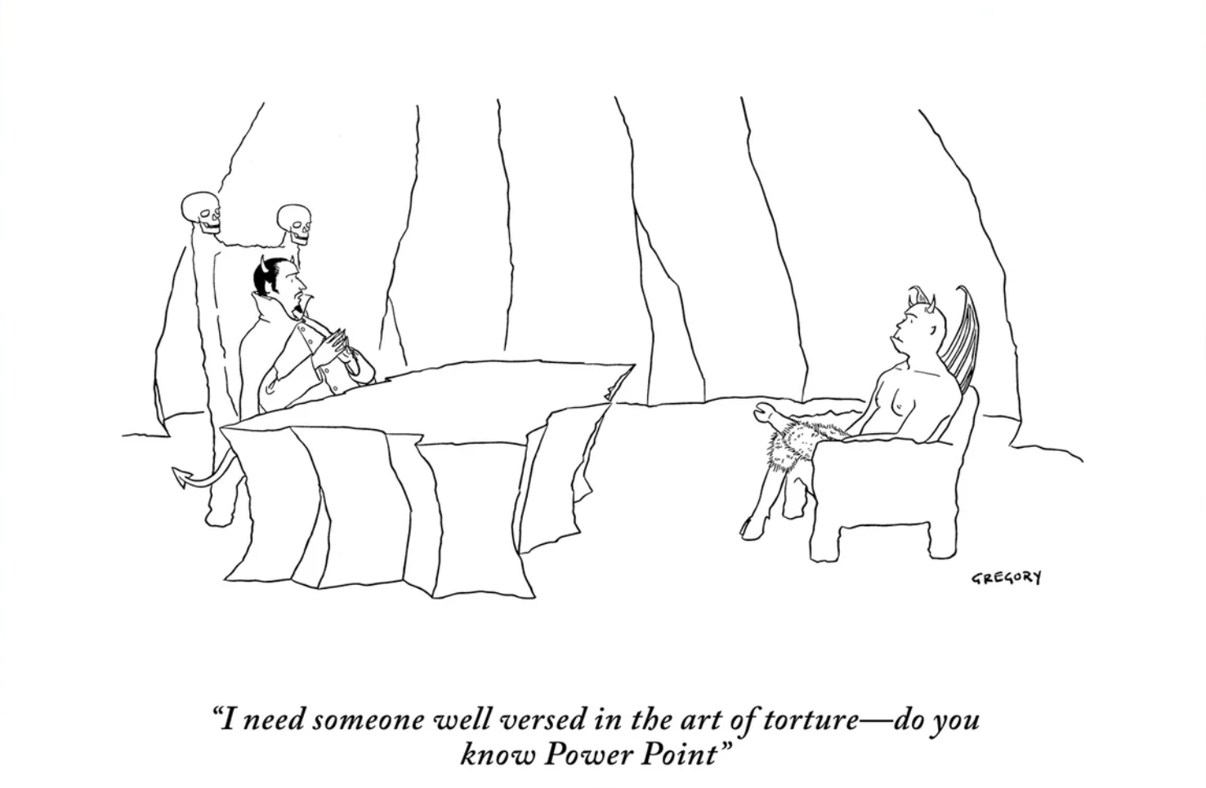
In a nutshell, effective visuals help …
Subject
Primer
… inspire action from the audience
… catch the audience’s attention
Ultimate goal of dashboard / presentation inspire
Inspired people take action
… maximise understanding
Always a challenge to keep people engaged
Especially over zoom meetings
Our brains process visuals quicker than text
Due to working memory and cognitive load

Slide 4
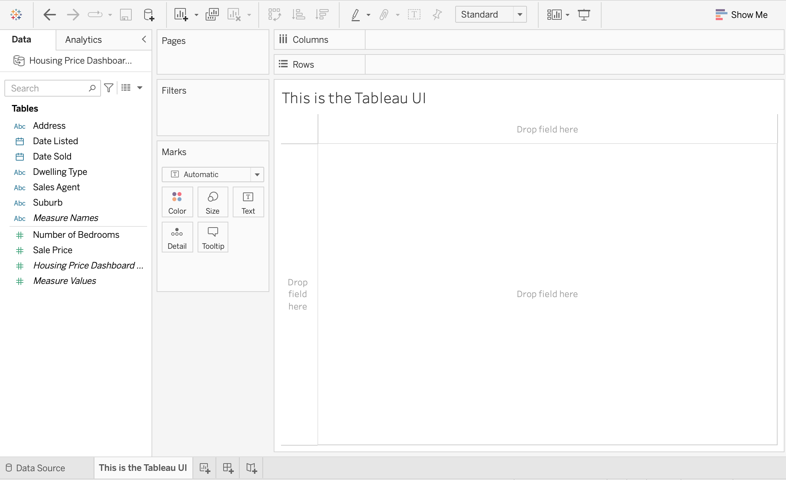
Refresher on Tableau UI
Admin
Details
Column and Row Shelves
Data Pane
Marks Card
Canvas
Workspace

Slide 5
Dataset description
Admin
Details
326 records for housing sales made from Q1 2017 to Q1 2022
Contains the following information
Variable Name | Date Type | Format
Address | Location | String
Suburb |  | String
Dwelling Type | Housing characteristics | String
Number of Bedrooms |  | Numeric
Sales Agent | Sales information | String
Sale Price |  | Numeric
Date Listed |  | Date
Date Sold |  | Date

Slide 6
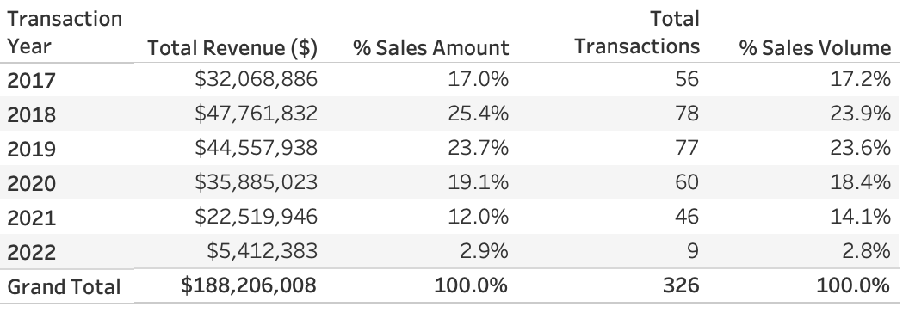
Tables are most effective for data visualsation!
Problem Statement
“Aren’t revenue and transaction proportions similar?”
- Well meaning stakeholder / sometimes boss

Slide 7
More important question is, “What’s next”?
Problem Statement
So what if we are right about proportions?
Purely academic exercise
Lulls us into a false sense of control over the situation
Is proportion between transaction and revenue the most important KPI?
Examining the shape / time trend of the data with graphs
First principle, understanding Panel Data with trends
Perform drilldown based on direction suggested by trend analysis
Personal rule of thumb: Follow the money
Never wrong to focus on revenue / production initially

Slide 8
Let’s build a dashboard
Practical
Session
Switching to tableau view to create from scratch a dashboard with
A line graph to see time trend
Drilldown analysis via
Slope chart looking at agent production share
Comparing two time periods
Please feel free to follow along with the following slides as reference

Slide 9
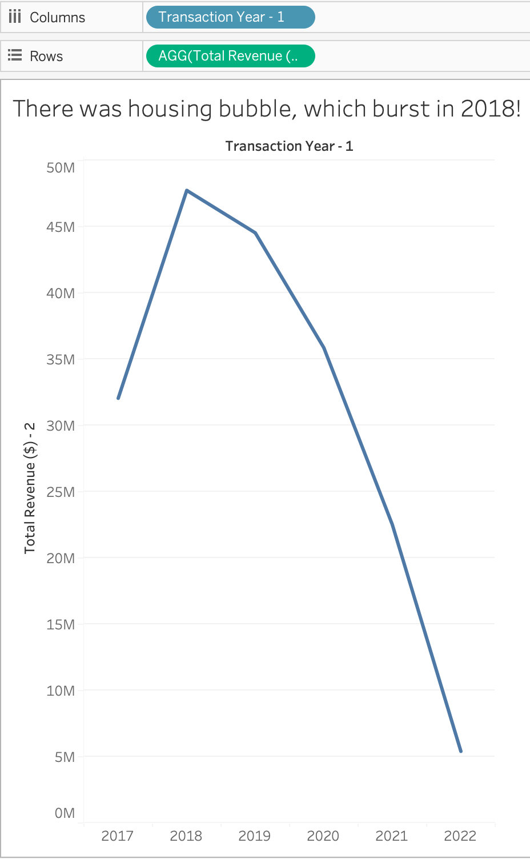
Trend suggests a housing bubble prior!
Overall
Analysis
Create aggregation variables, namely
Year of date sold; [Transaction Year – 1]
“YEAR([Date Sold])”
Total revenue; [Total Revenue ($) – 2]
SUM([Sale Price])
Create line graph by the following
[Transaction Year – 1] in Columns shelf
[Total Revenue ($) – 2] in Rows shelf
Select “Line” chart type in Marks

Slide 10
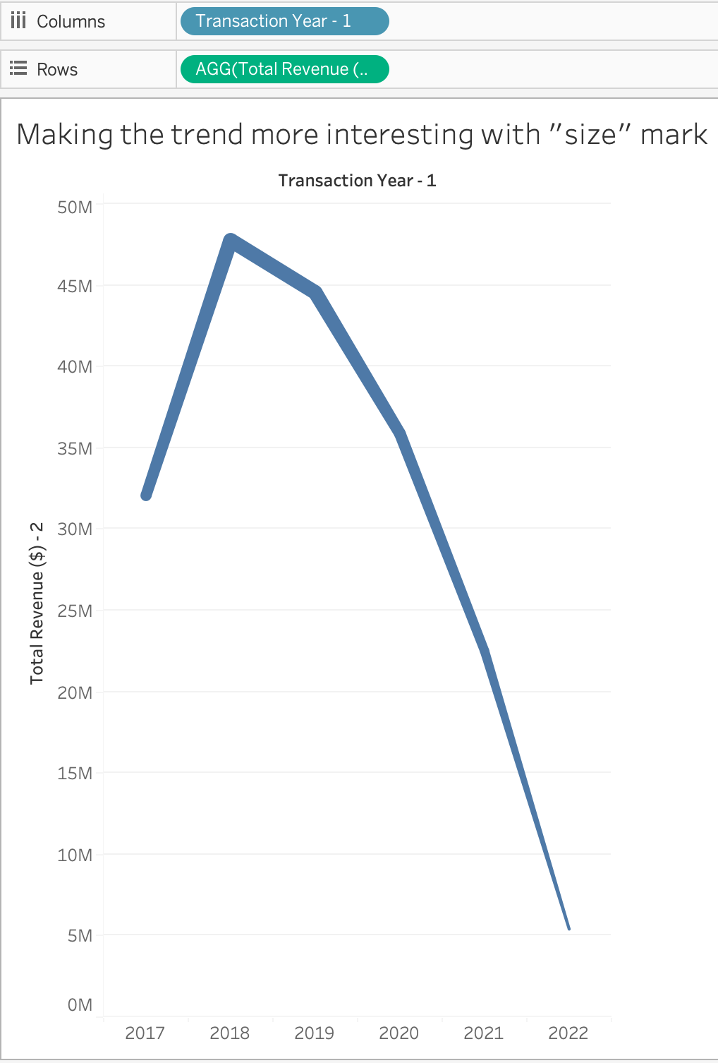
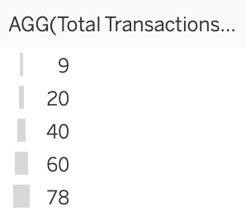
Adding another dimension in the line graph
Overall
Analysis
Create aggregation variables, namely
Total Transactions; [Total Transactions – 3]
“COUNTD([Address])”
Had verified earlier that this variable is unique in dataset
Showing Total Transactions in graph
Drag [Total Transactions – 3] into Size Mark
If done correctly Transactions will now display as line thickness
Helps make line graph less boring in general

Slide 11
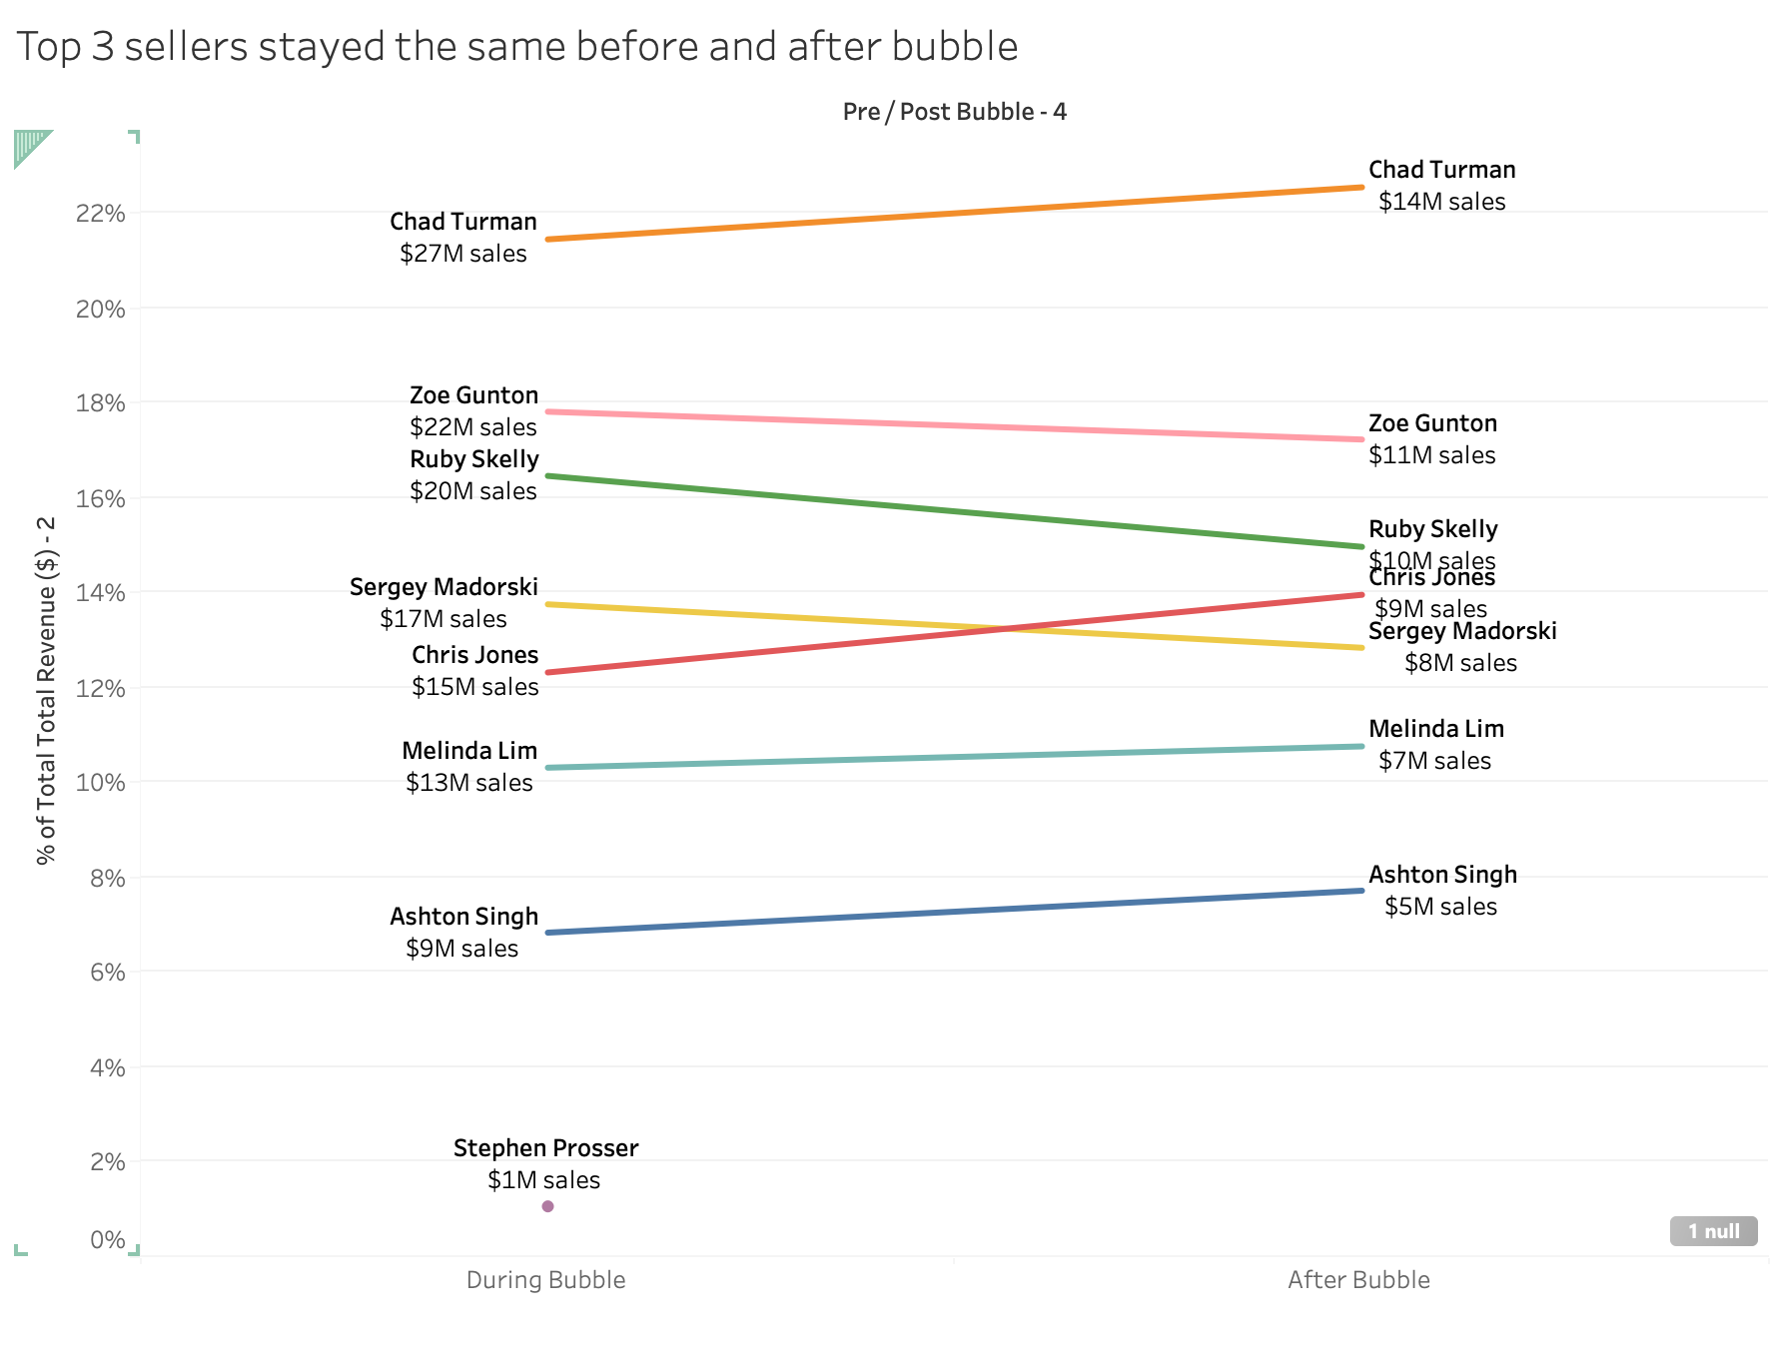
Top 3 agents make up >50% of revenue, pre- and post-bubble
Drilldown
Analysis
Create aggregation variable, namely
Pre-post bubble indicator; [Pre / Post Bubble - 4]
“IF YEAR([Date Sold])<=2019 THEN 'During Bubble’ ELSE 'After Bubble’ END”
Create line graph by the following
[Pre / Post Bubble - 4] in Columns shelf
[Total Revenue ($) – 2] in Rows shelf
Right click [Total Revenue ($) – 2] to change
Quick Table Calculation, Percent of Total
Compute Using, Table (Down)
In Marks
Select ”Line” chart type
Drag [Sales Agent] to colour
Drag [Sales Agent] and [Total Revenue ($) – 2] to text
Click Label, set Marks to Label as “Line Ends”
Format Revenue to display as “Currency (Custom)”; $0M

Slide 12
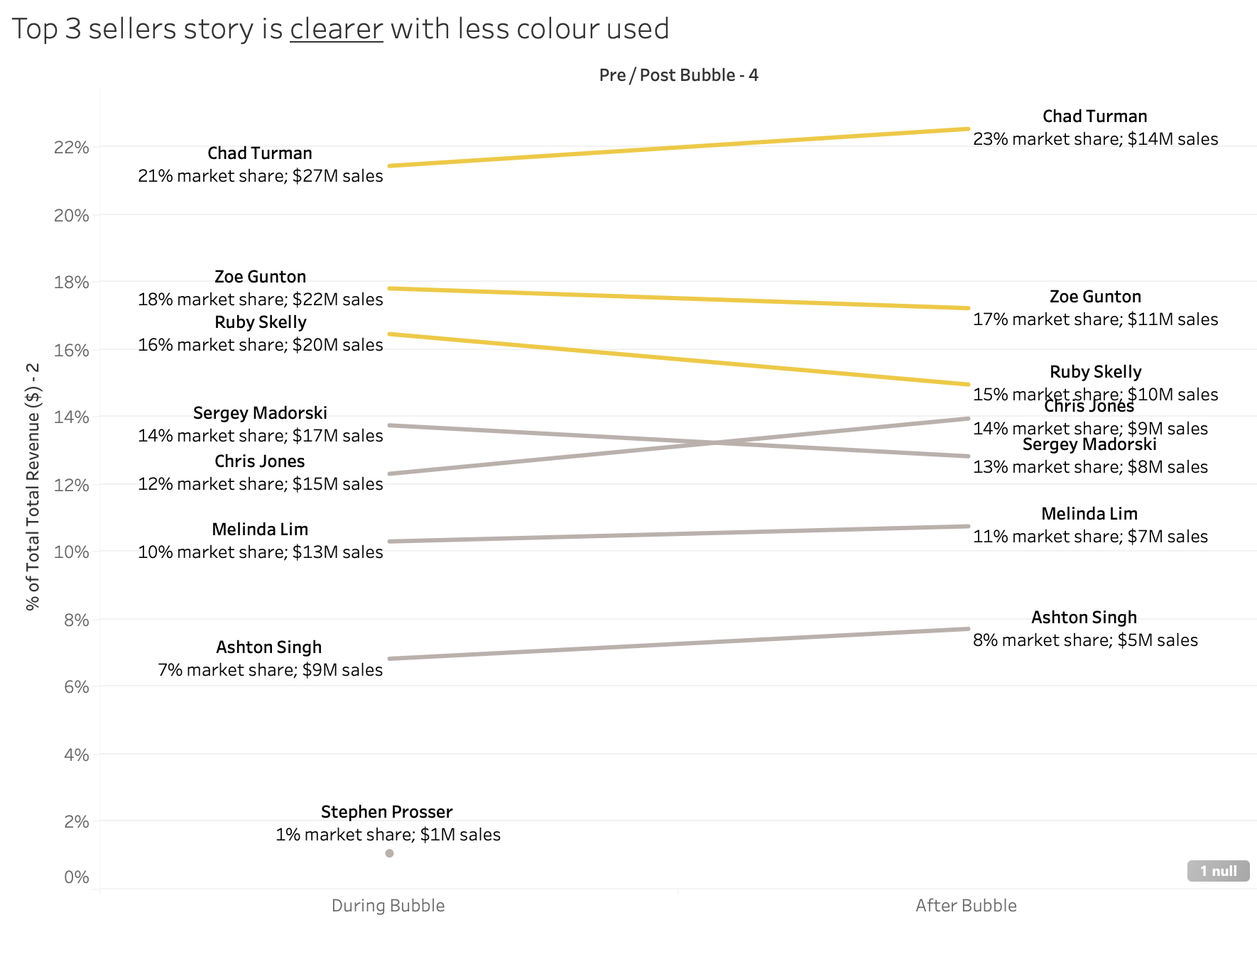
Top 3 agents point comes out better with less colour
Drilldown
Analysis
Create aggregation set, namely
Top 3 agent indicator; [Top 3 Agent Set - 5]
Set using Top 3 by Sum of [Sales Price]
In Marks
Replace colour with [Top 3 Agent Set - 5]
Edit colours as desired
Chose “Yellow” and “Grey” for this example
Edit Label to show
[Sales Agent]
Total Revenue % of Total and Nominal amount in single line

Slide 13
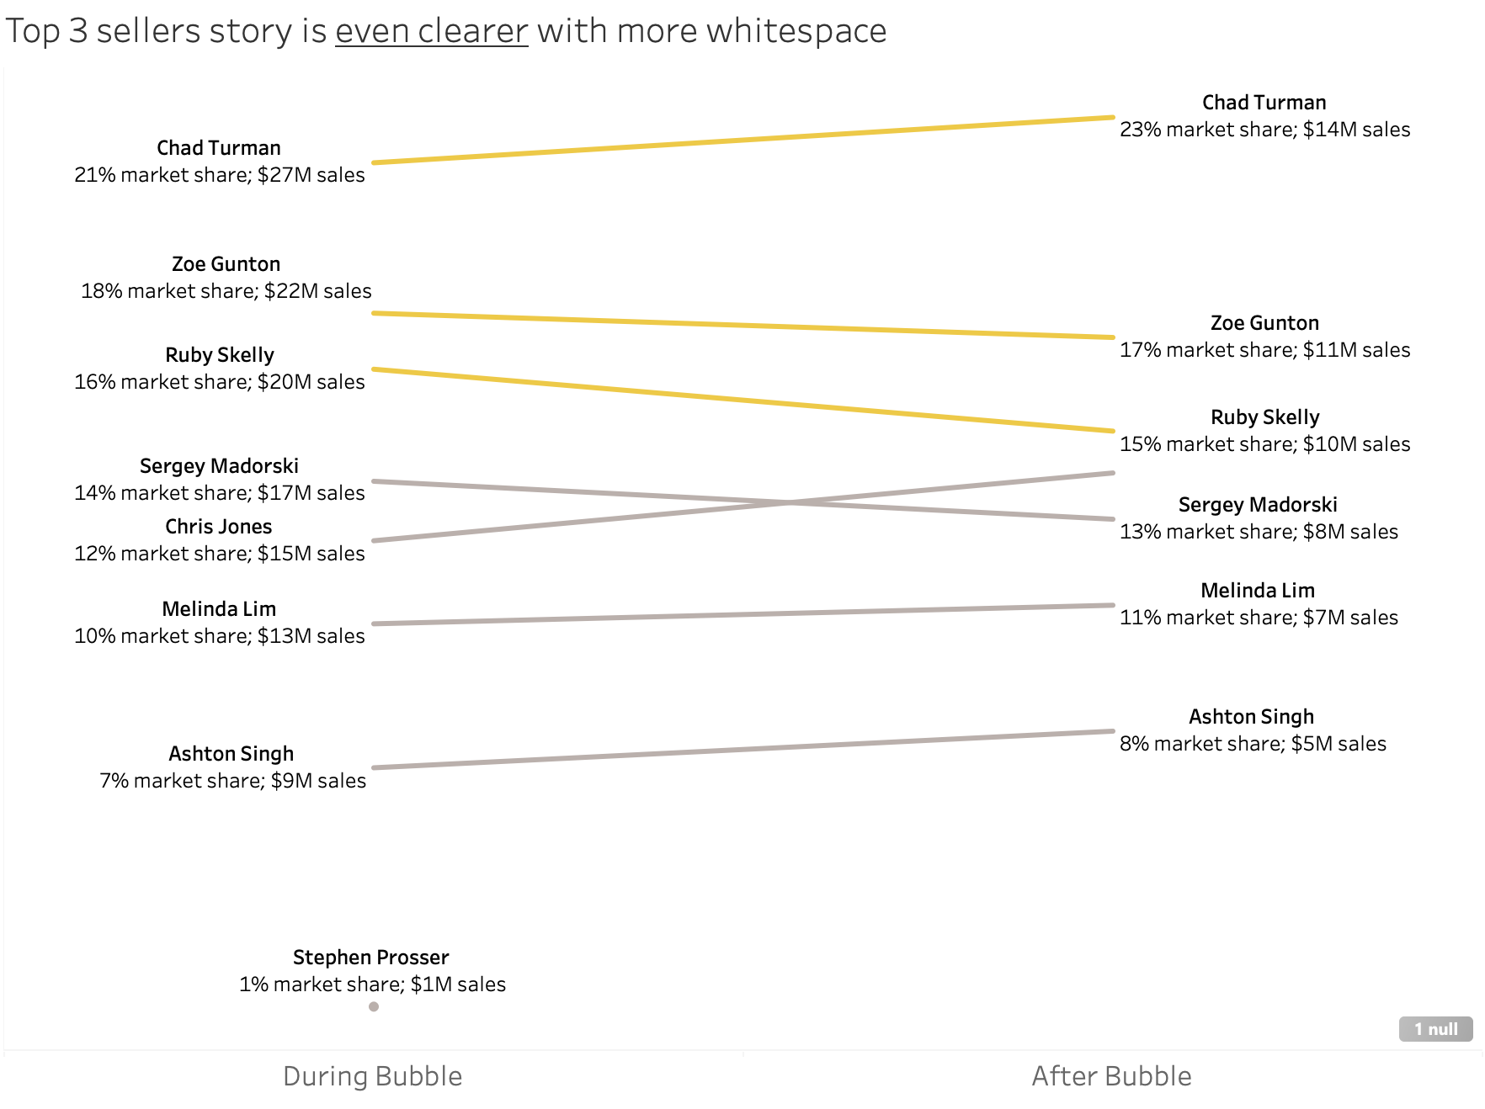

Adding white space to help bring out the story in the viz
Drilldown
Analysis
Remove axis
Uncheck “Show Header” on Y-axis
Labels redundant given text edits
Allow “Hide Field Labels for Columns”
Remove grid lines
Right click on graph, select “Format”
Click on “Lines” icon
In Rows, change Grid Lines to “None”
Edit Label to show
[Sales Agent]
Total Revenue % of Total and Nominal amount in single line
Increase Table Header to font size “12”

Slide 14
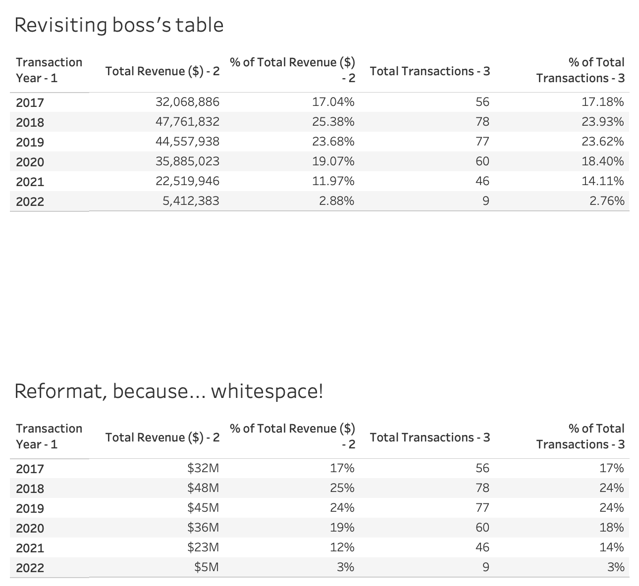
Adding white space also helps with tables too
Tables &
White space
Before
After
This is especially so as we “read” tables
Formatted Revenue to “$0M” and Percentages to 0 decimal place
Allows table to be less heavy reading
Point on proportion still holds with less precise numbers
May be politically correct to include data table, to “appease” technical stakeholders

Slide 15
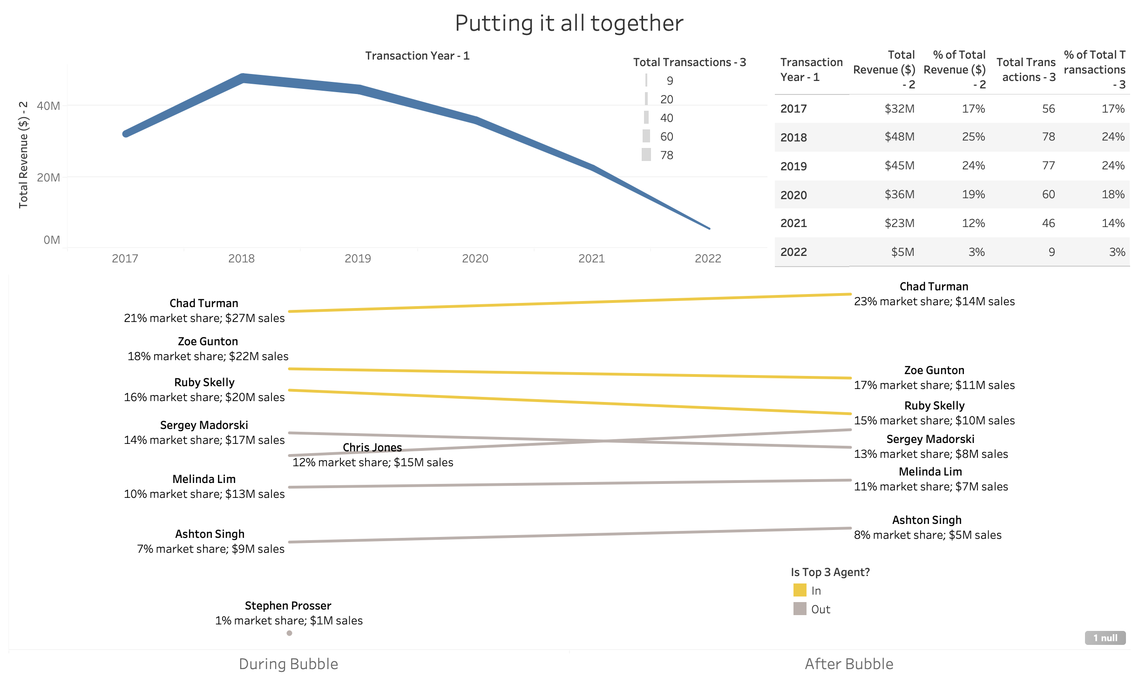
Consolidating a DB that guides the users eye
Consolidated
Dashboard

